Slide 1
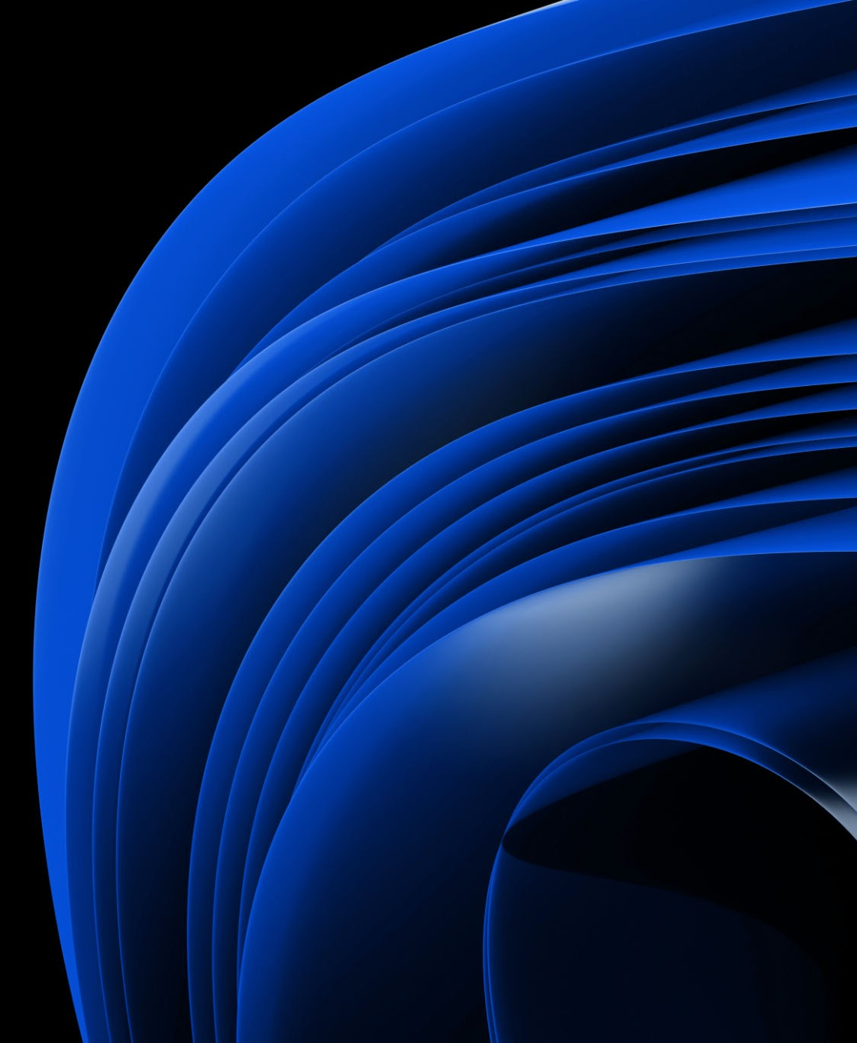
Sport Image Classification
Using CNN
Deep Learning

Slide 2
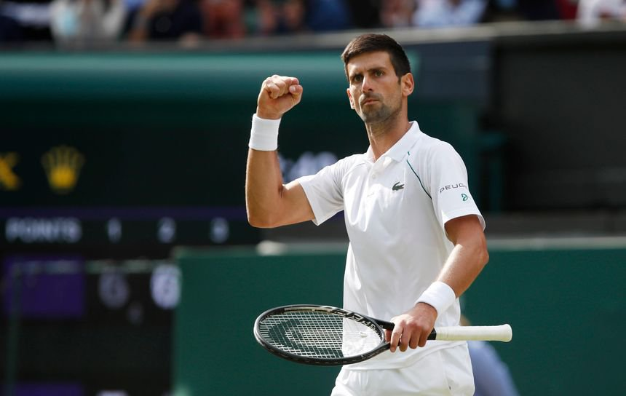
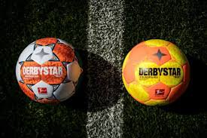
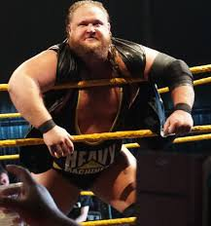
Dataset
8000 images of sports activities from Kaggle.
Seven sports are included.
Big variation in composition of photos, some are taken from professional sporting events, some are advertisements, others are seemingly from non-professional sporting events.

Slide 3
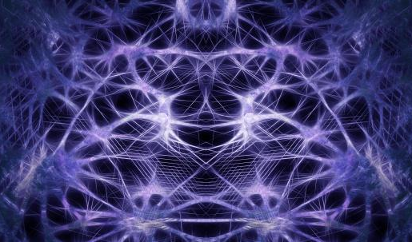

Goal of Our Analysis
Correctly classify images to their corresponding sport
Explore different architectures
Color vs Grayscale

Slide 4
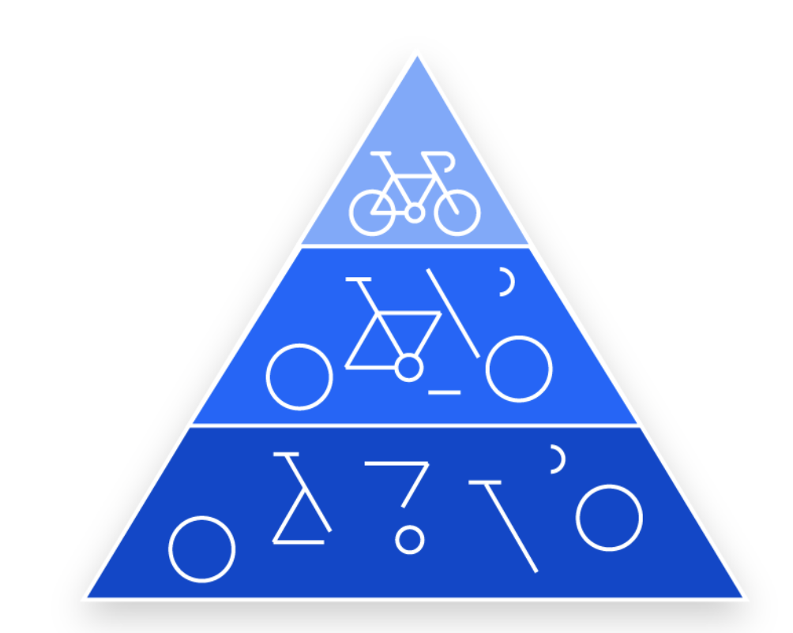
Convolutional Neural Networks
Convolutional layers
Pooling Layers
Drop-out
Consist of Convolutional layers
MaxPooling or AVGPooling. Downsamples.
Prevent Overfitting
Kernels/Filters
Flattening and Fully Connected
Filters extract meaningful features from the data.
Transformed into a flattened vector that enters a softmax activation function

Slide 5
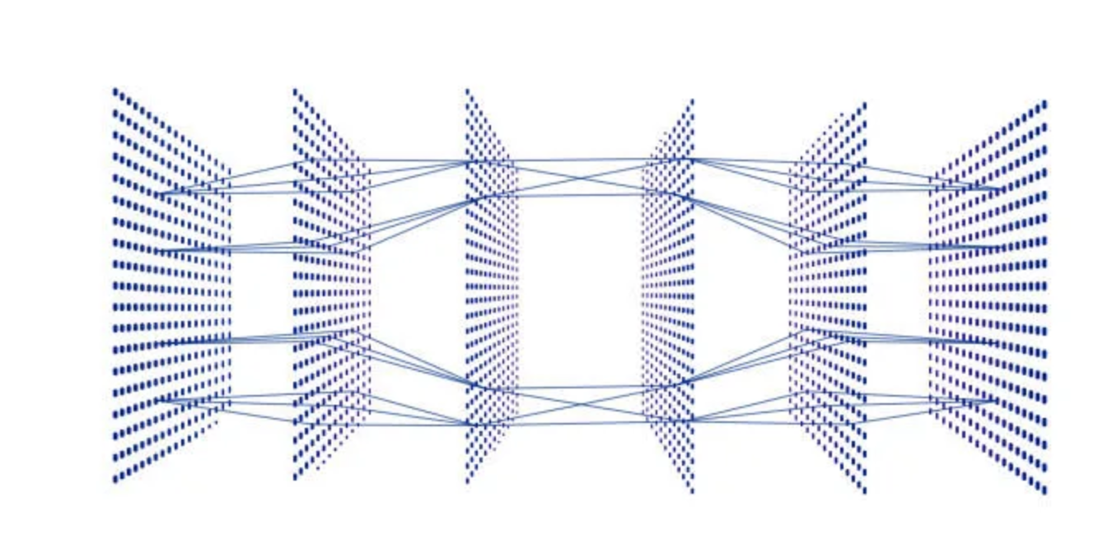
Convolutional Neural Networks

Slide 6
Baseline Architecture
3 conv Layers with 32 filters of size 3x3
Maxpooling layer after each Convlayer
Softmax
Image
Conv2D
Conv2D
Conv2D
Image
Image
Maxpool
Maxpool
Maxpool
Sport

Slide 7
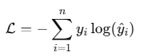
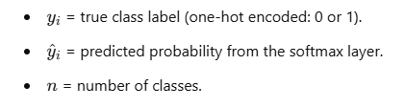
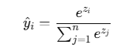
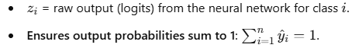
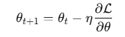
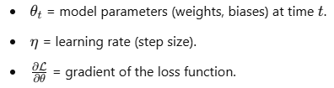
Objective function
Categorical cross entropy
Softmax Layer
Method of penalising confident incorrect predictions made from class-wise log probabilities.
Converts logits into probability distributions over n classes.
Gradient Descent
Optimise the loss function using gradient descent

Slide 8
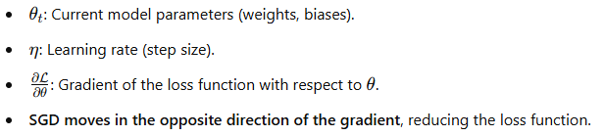
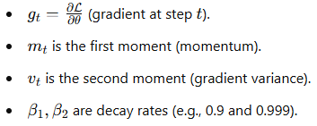
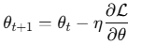
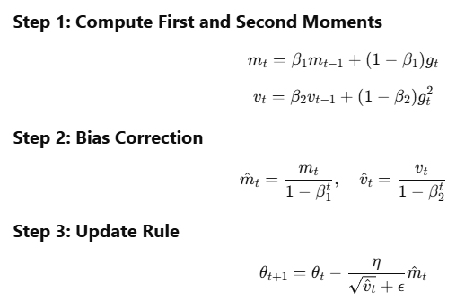
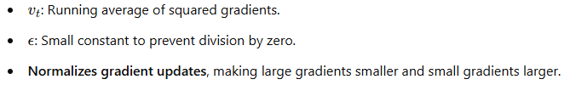
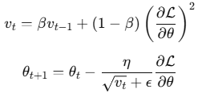
Optimiser Functions
SGD
ADAM
RMSPROP

Slide 9
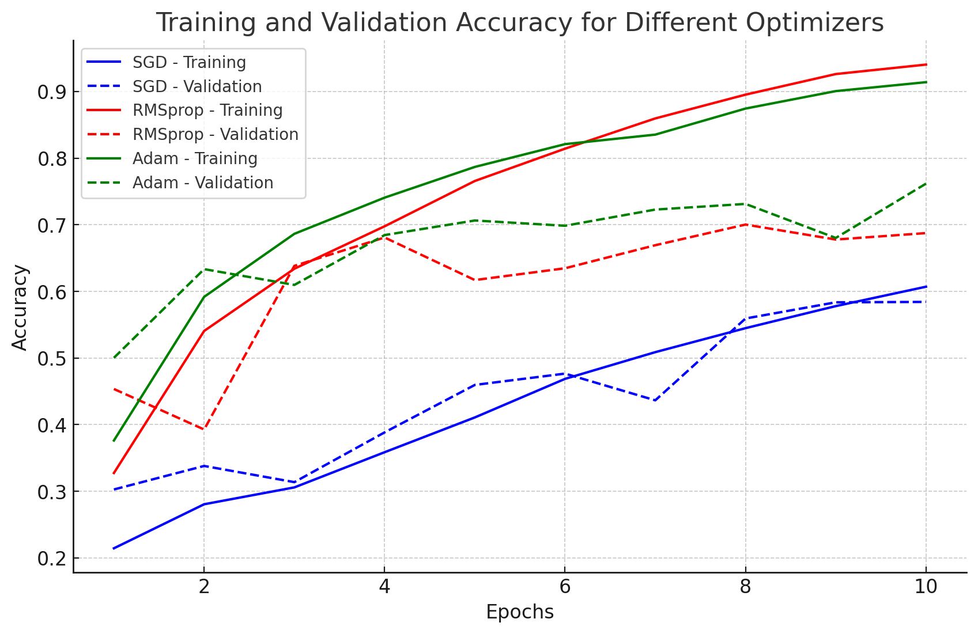

Slide 10
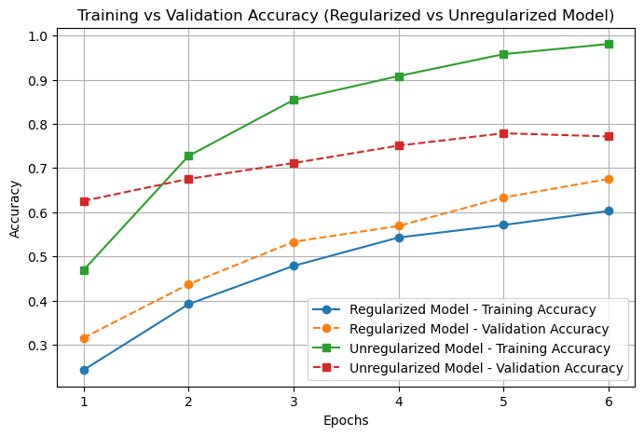
No regularization Vs dropout(0.5) introduced. Two ConvLayers

Slide 11
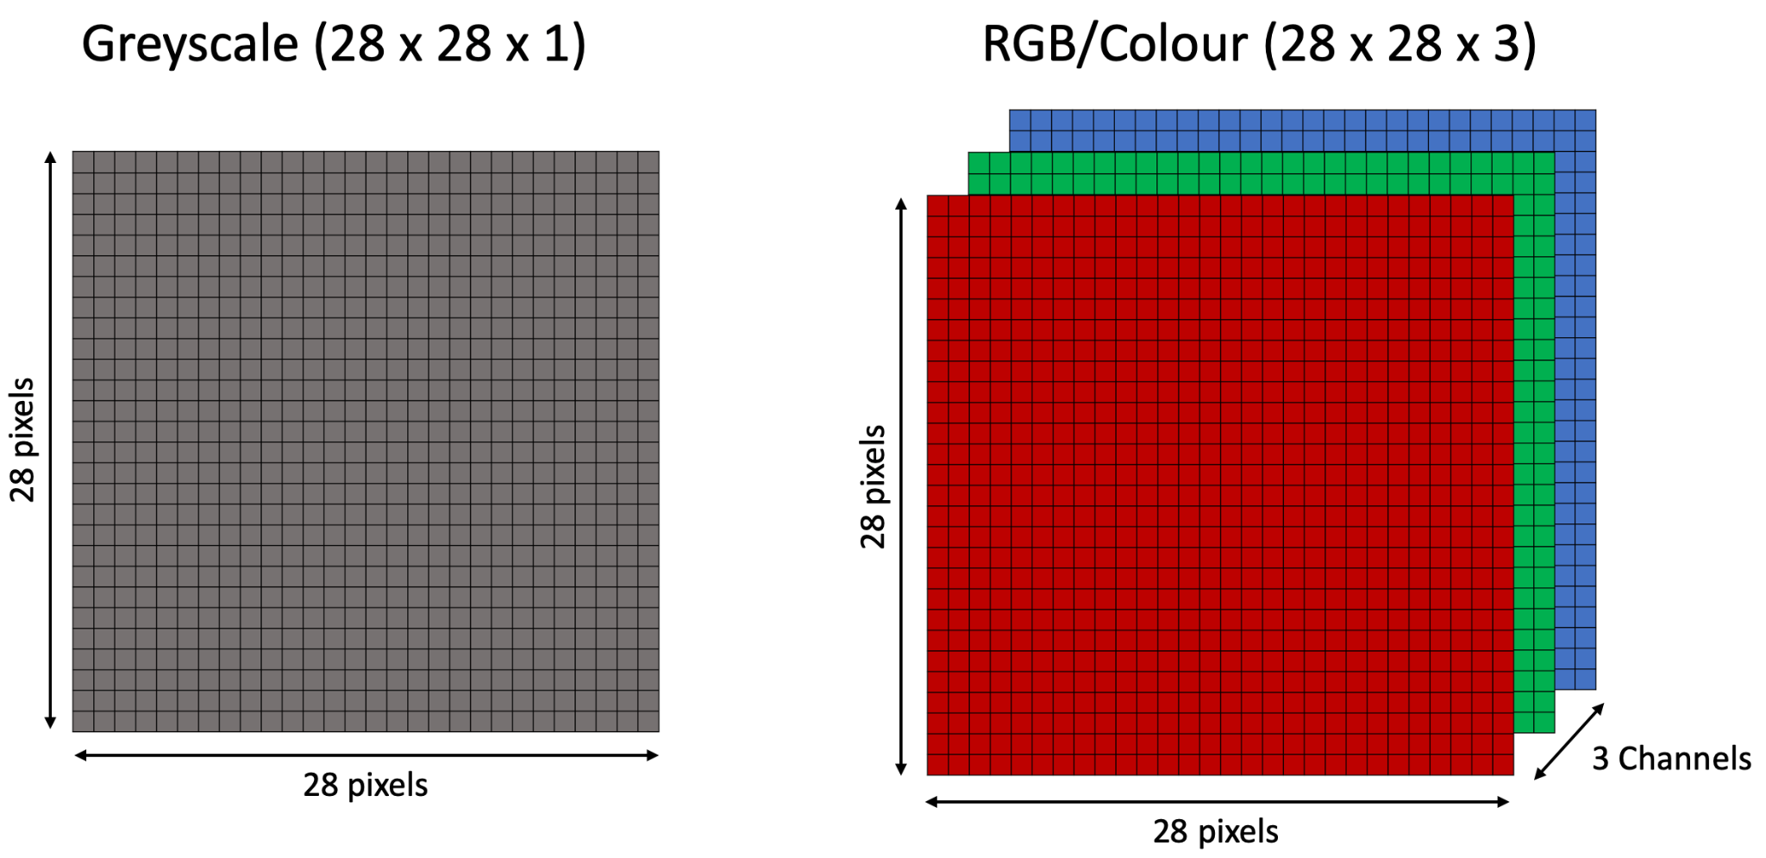
Grayscale vs. Color

Slide 12
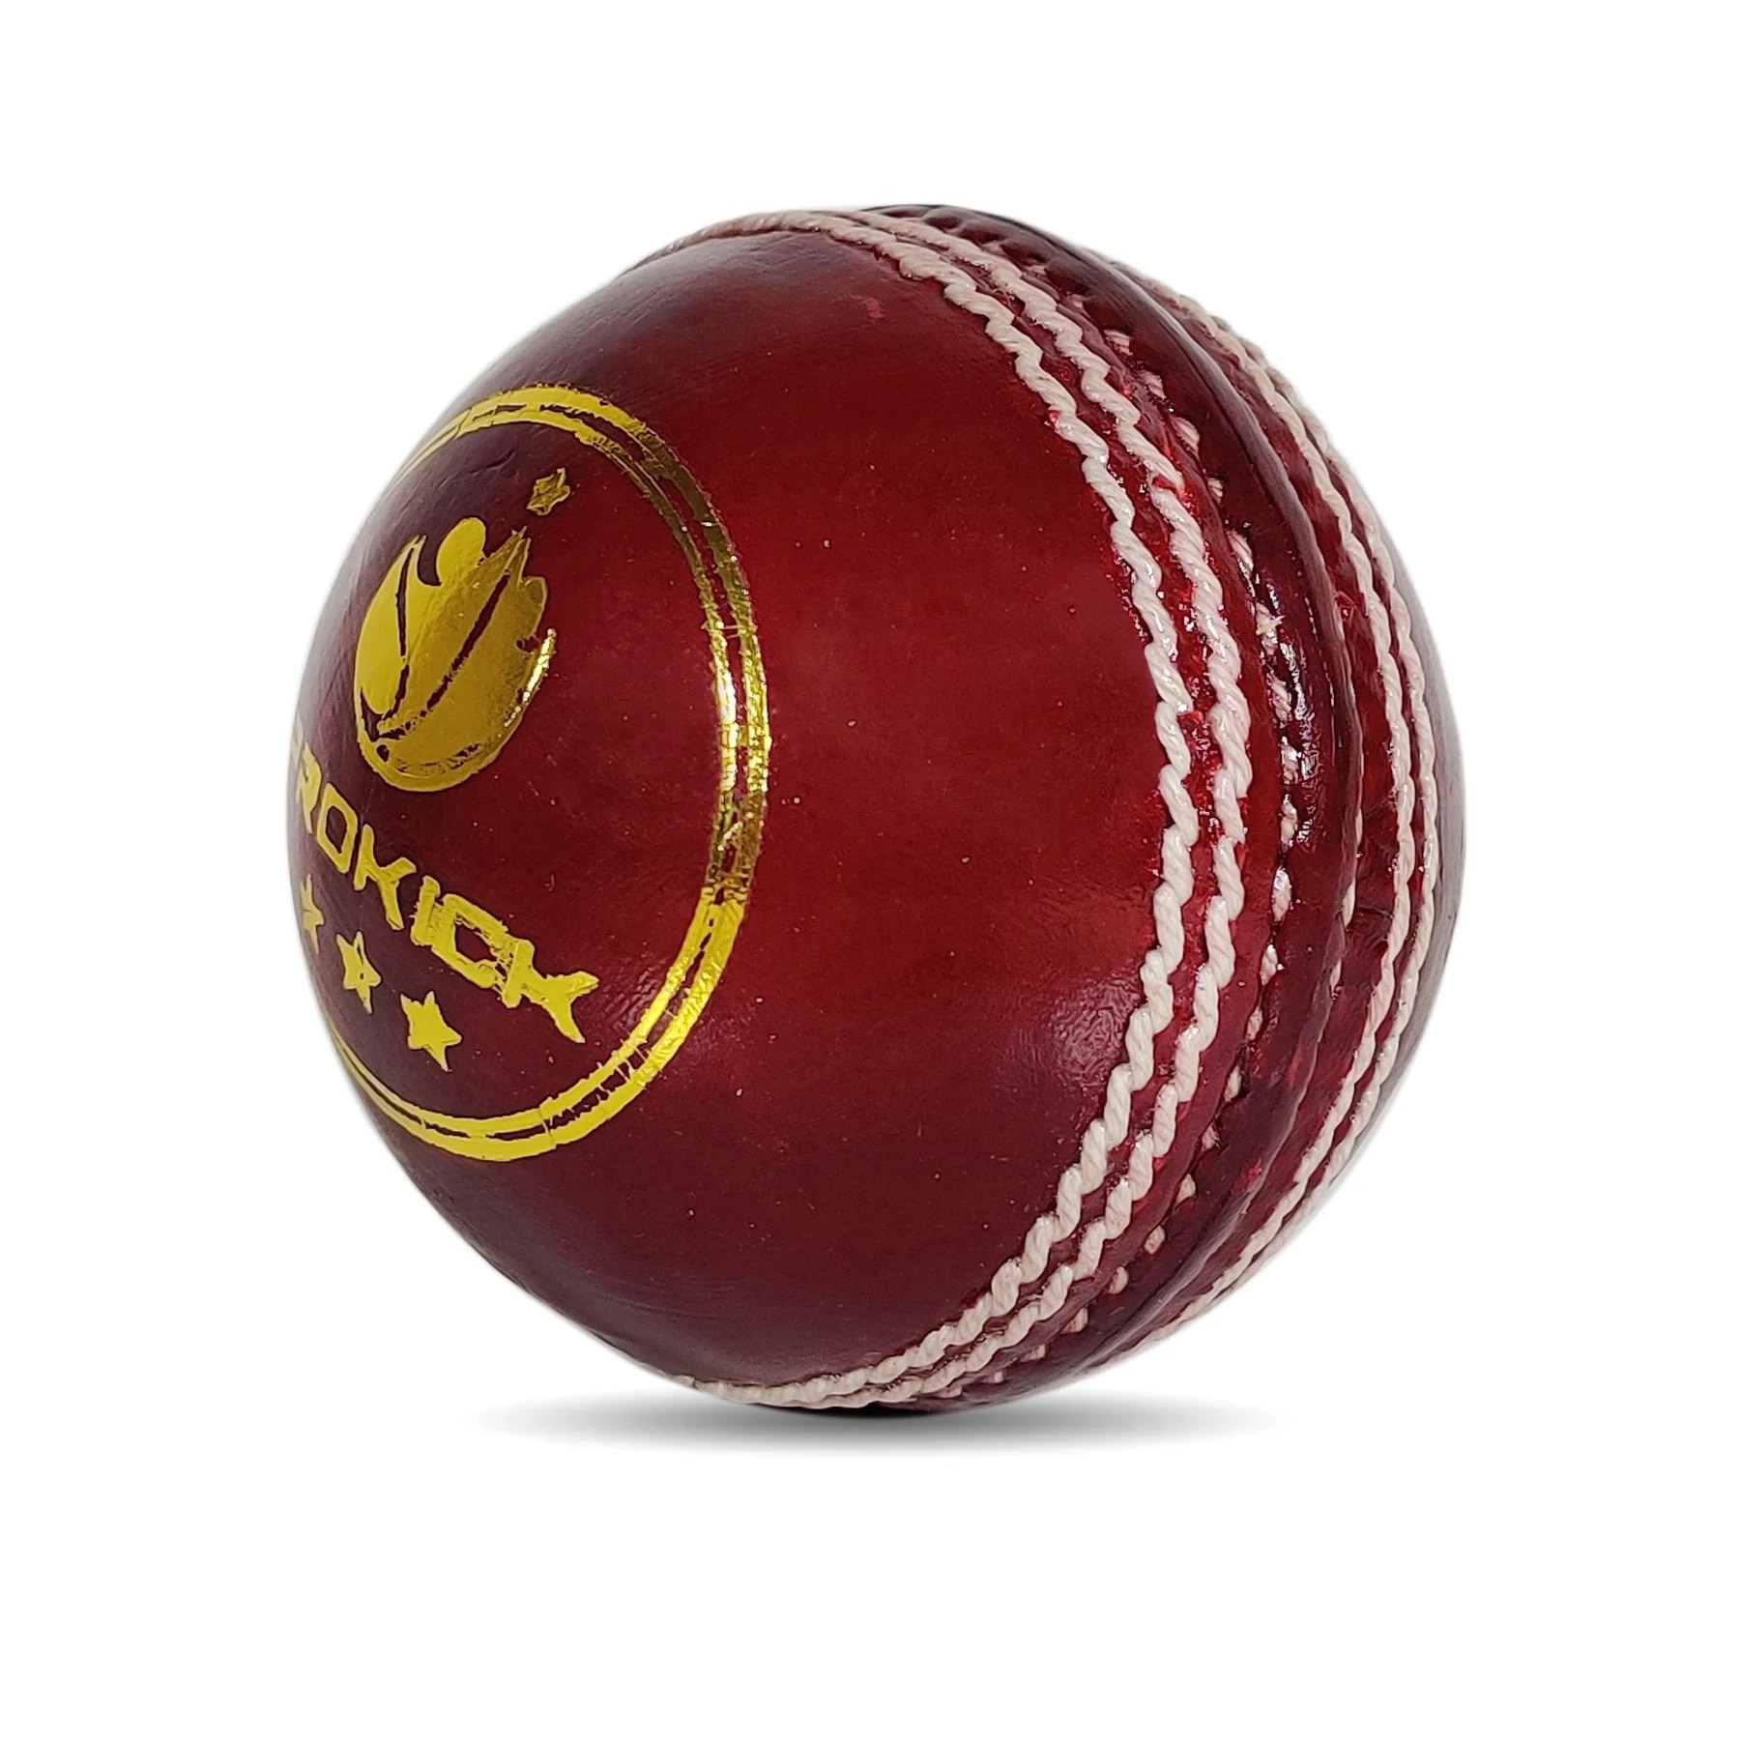
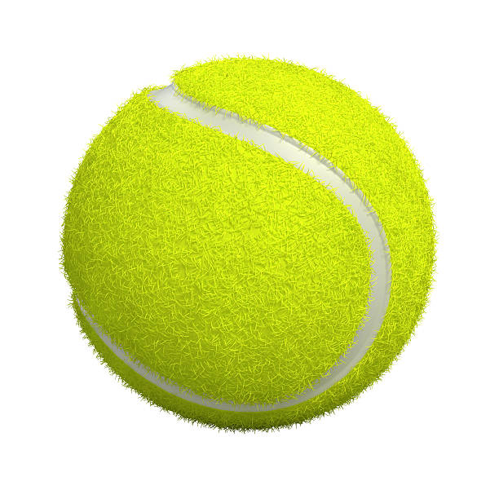
Grayscale vs. Color

Slide 13
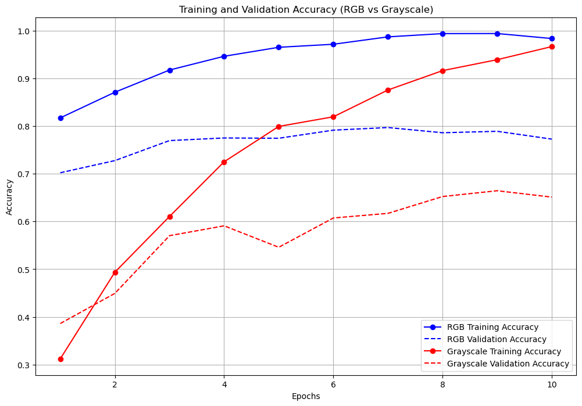

Slide 14
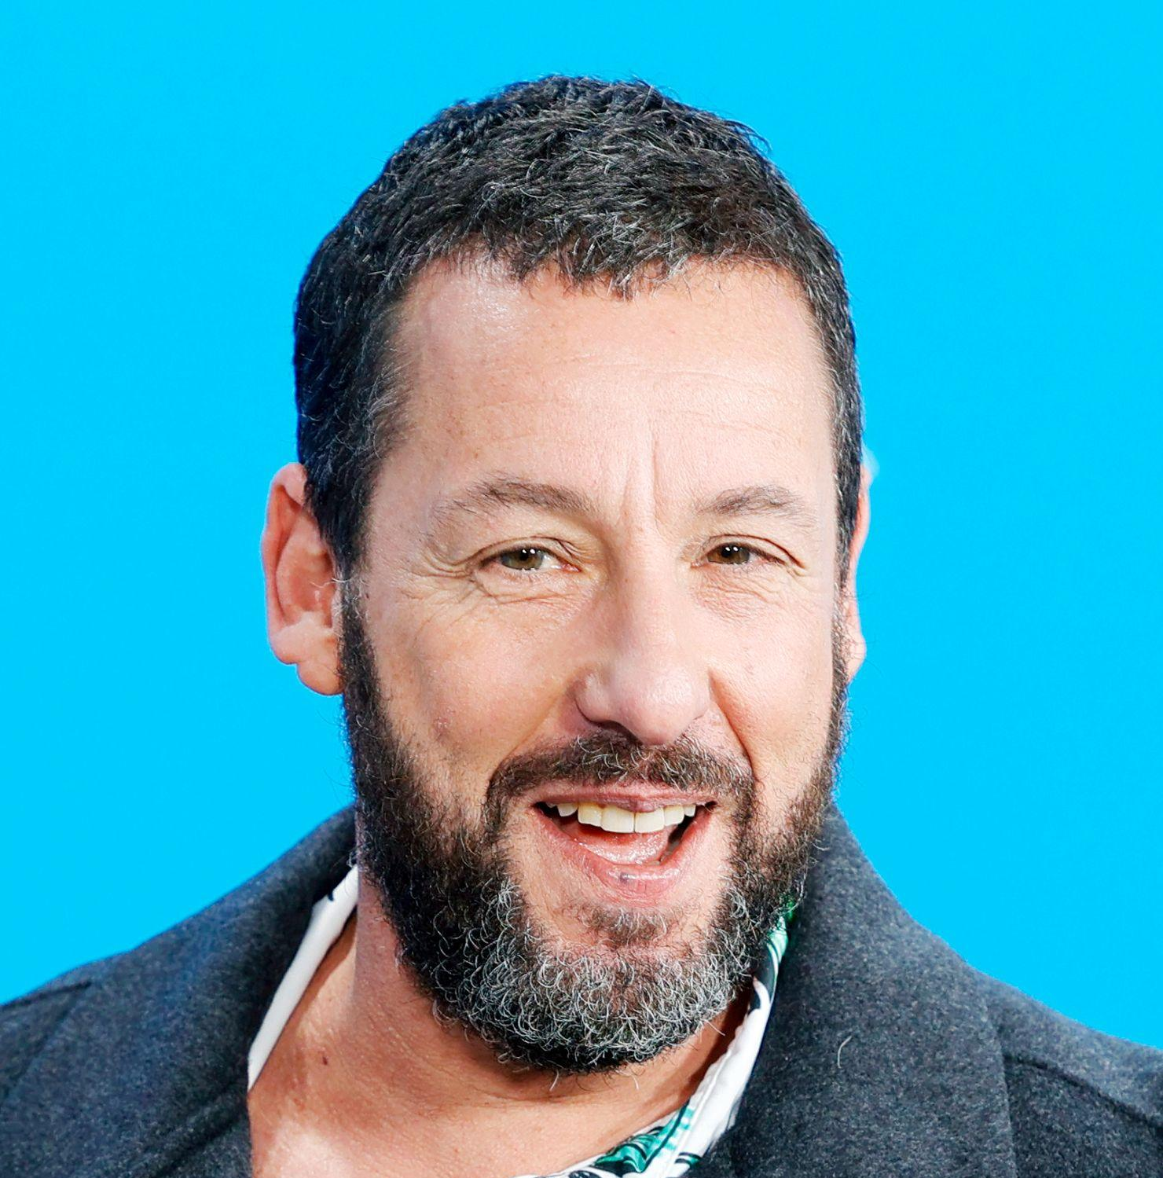
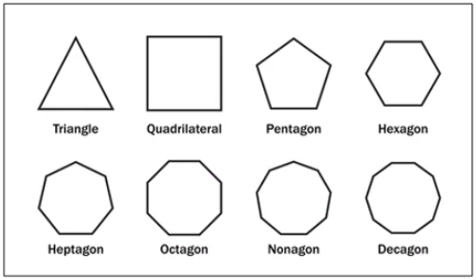
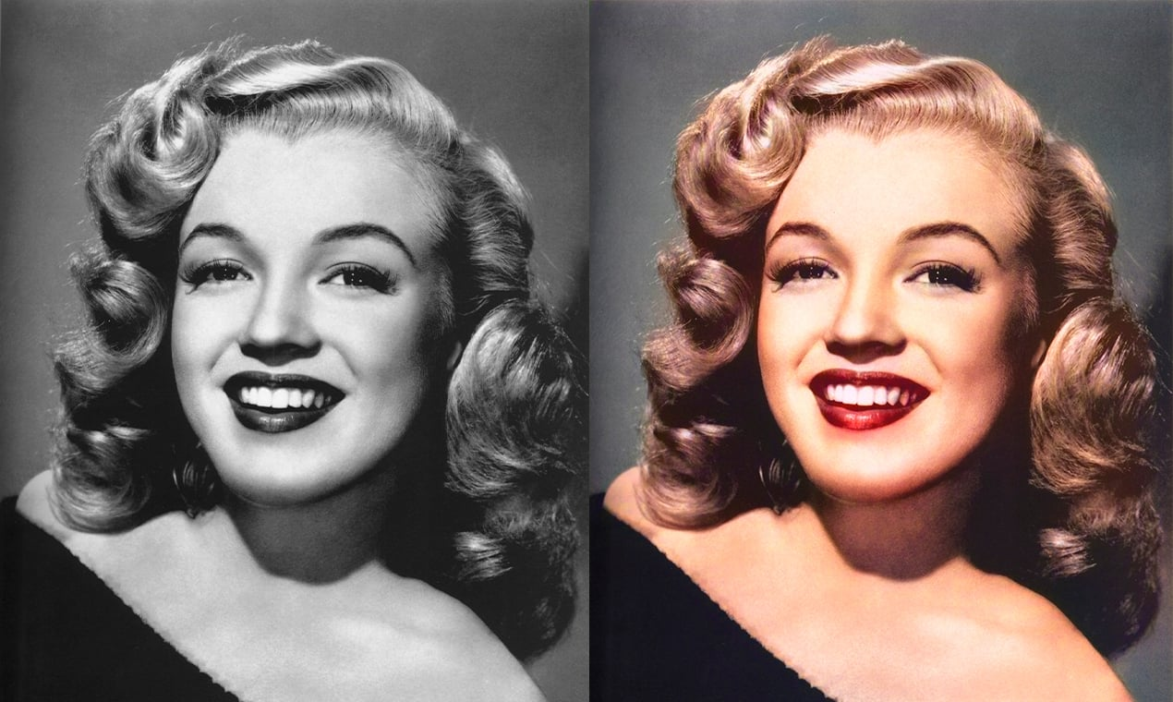
Results
Accuracy
The different architectures usually end up with a testing accuracy of around 76-78%
Optimizers
Regularisation
Color VS Gray
ADAM optimizer clearly the best. Reconciles with previous literature
Regularisation in the form of drop-out does not improve the model
Color includes relevant information thus the colour scale model was more accurate

Slide 15
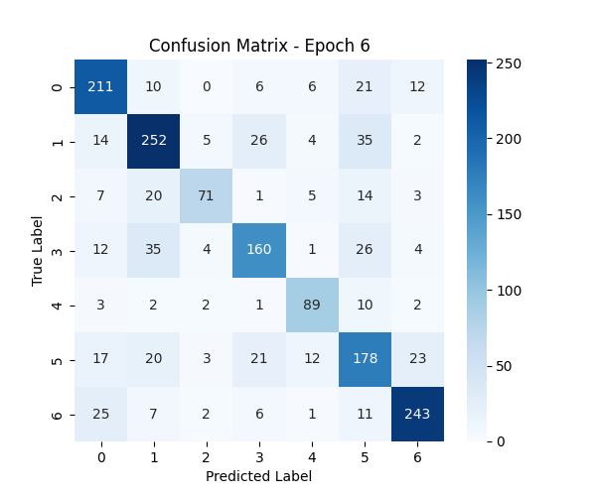
Final Baseline Model architecture
Layer (type) | Output Shape | Param #
Rescaling | (None, 180, 180, 3) | 0
Conv2D | (None, 178, 178, 32) | 896
MaxPooling2D | (None, 89, 89, 32) | 0
Conv2D | (None, 87, 87, 32) | 9,248
MaxPooling2D | (None, 43, 43, 32) | 0
Conv2D | (None, 41, 41, 32) | 9,248
MaxPooling2D | (None, 20, 20, 32) | 0
Flatten | (None, 12800) | 0
Dense | (None, 32) | 409,632
Dense | (None, 7) | 231
Total params: 326,999 (1.25 MB)
Trainable params: 108,999 (425.78 KB)
Non-trainable params: 0 (0.00 B)
Optimizer params: 218,000 (851.57 KB)
['Badminton', 'Cricket', 'Karate', 'Soccer', 'Swimming', 'Tennis', 'Wrestling']

Slide 16
Discussion
Training data
ResNet
Diverse set of images
Architecture

Slide 17
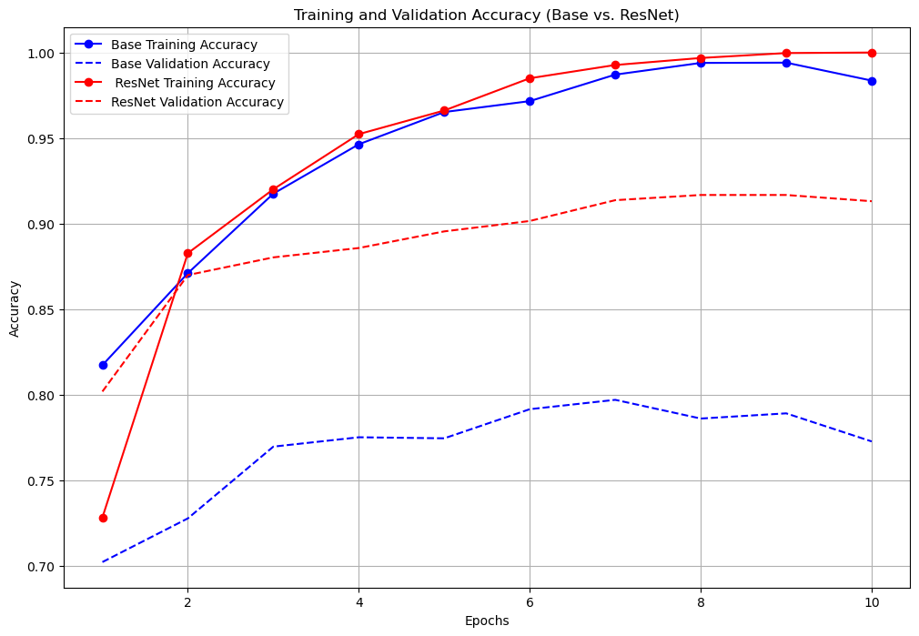

Slide 18
Contribution Statement
Dennis: Baseline model, optimiser testing, objective function and optimiser definitions,
Evagelos: Code to restructure dataset, loading data, converting to grayscale, ResNet-model
Felix: Explanation of CNN and our baseline architecture. Testing of impact of amount of layers and the effect of regularization on model accuracy.

